Slide 1

Customer Retention Project
By
Gargi Saha Samanta

Slide 2

Content
1. Problem Statement
Data Summary
Exploratory Data Analysis
Conclusion

Slide 3

Problem Statement
Customer satisfaction has emerged as one of the most important factors that guarantee the success of online store; it has been posited as a key stimulant of purchase, repurchase intentions and customer loyalty. A comprehensive review of the literature, theories and models have been carried out to propose the models for customer activation and customer retention. Five major factors that contributed to the success of an e-commerce store have been identified as: service quality, system quality, information quality, trust and net benefit. The research furthermore investigated the factors that influence the online customers repeat purchase intention. The combination of both utilitarian value and hedonistic values are needed to affect the repeat purchase intention (loyalty) positively. The data is collected from the Indian online shoppers. Results indicate the e-retail success factors, which are very much critical for customer satisfaction.

Slide 4

Data Summary
Personal Detail:
Gender of respondent’,
'How old are you?’,
'Which city do you shop online from?’,
'What is the Pin Code of where you shop online from?’,
'Since How Long You are Shopping Online ?’,
'How many times you have made an online purchase in the past year?’
Customer's device detail:
'How do you access the internet while shopping on-line?’,
'Which device do you use to access the online shopping?’,
'What is the screen size of your mobile device?’,
'What is the operating system (OS) of your device?’

Slide 5
Customer_activity before shopping
'What browser do you run on your device to access the website?’,
'Which channel did you follow to arrive at your favorite online store for the first time?’,
'After first visit, how do you reach the online retail store?’,
'How much time do you explore the e- retail store before making a purchase decision?’,
'What is your preferred payment Option?’,
'How frequently do you abandon (selecting an items and leaving without making payment) your shopping cart?’,
'Why did you abandon the �Bag�, �Shopping Cart�?’

Slide 6
Services:
‘The content on the website must be easy to read and understand’,
'Information on similar product to the one highlighted is important for product comparison’,
'Complete information on listed seller and product being offered is important for purchase decision.’,
'All relevant information on listed products must be stated clearly', 'Ease of navigation in website’,
'Loading and processing speed', 'User friendly Interface of the website', 'Convenient Payment methods’,
'Trust that the online retail store will fulfill its part of the transaction at the stipulated time’,
'Empathy (readiness to assist with queries) towards the customers', 'Being able to guarantee the privacy of the customer’,
'Responsiveness, availability of several communication channels (email, online rep, twitter, phone etc.)’,
'Online shopping gives monetary benefit and discounts', 'Enjoyment is derived from shopping online’,
'Shopping online is convenient and flexible’,
'Return and replacement policy of the e-tailer is important for purchase decision’, 'Fast loading website speed of website and application’,
'Reliability of the website or application', 'Quickness to complete purchase’,
'Availability of several payment options’,
'Speedy order delivery', 'Privacy of customers� information’,
'Security of customer financial information', 'Perceived Trustworthiness’,
'Presence of online assistance through multi-channel’

Slide 7
Policies and commitments
'Offering a wide variety of listed product in several category',
'Provision of complete and relevant product information',
'Monetary savings',
'The Convenience of patronizing the online retailer',
'Shopping on the website gives you the sense of adventure',
'Shopping on your preferred e-tailer enhances your social status',
'You feel gratification shopping on your favorite e-tailer',
'Shopping on the website helps you fulfill certain roles',
'Getting value for money spent'

Slide 8
Website_Specification
'Easy to use website or application',
'Visual appealing web-page layout', 'Wild variety of product on offer',
'Complete, relevant description information of products',
'Fast loading website speed of website and application',
'Reliability of the website or application',
'Quickness to complete purchase',
'Availability of several payment options', 'Speedy order delivery',
'Security of customer financial information',
'Perceived Trustworthiness',
'Presence of online assistance through multi-channel'

Slide 9
Feedback:
'Longer time to get logged in (promotion, sales period)’,
'Longer time in displaying graphics and photos (promotion, sales period)’,
'Late declaration of price (promotion, sales period)’,
'Longer page loading time (promotion, sales period)’,
'Limited mode of payment on most products (promotion, sales period)’,
'Longer delivery period', 'Change in website/Application design’,
'Frequent disruption when moving from one page to another’,
'Website is as efficient as before’

Slide 10

Exploratory Data Analysis ( EDA)

Slide 11
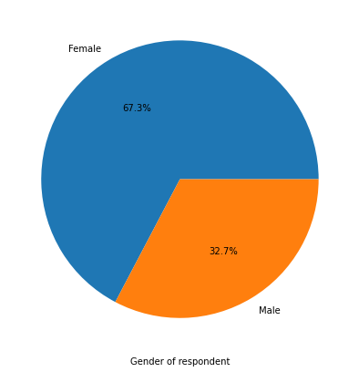
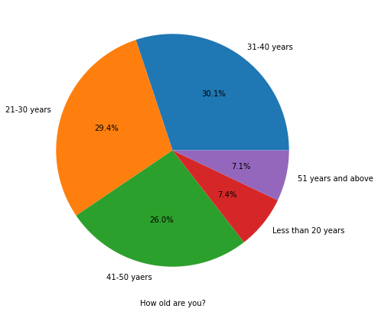
Personal Details Analysis
1.Female response is more than male almost double the male candidates.
2. 31 to 40 years old are responding most followed by 21-30yrs then 41-50yrs.

Slide 12
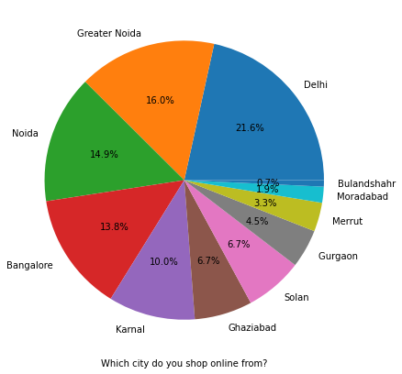
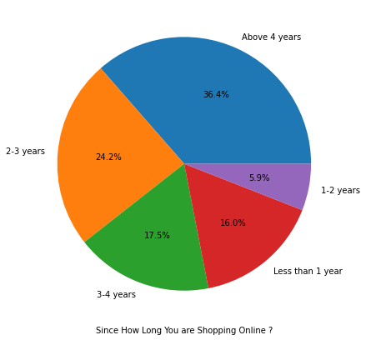
Personal Details:
3.Delhi people responding max then Noida and then Greater Noida.
4. The people shopping over 4 years are most in number.

Slide 13
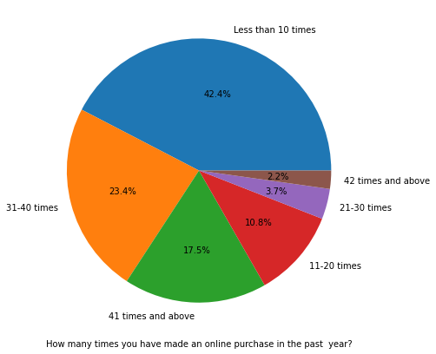
Purchase Detail in last year
Purchase in the past year is less than 10 times which should be increased. Mainly above 42 times band.

Slide 14
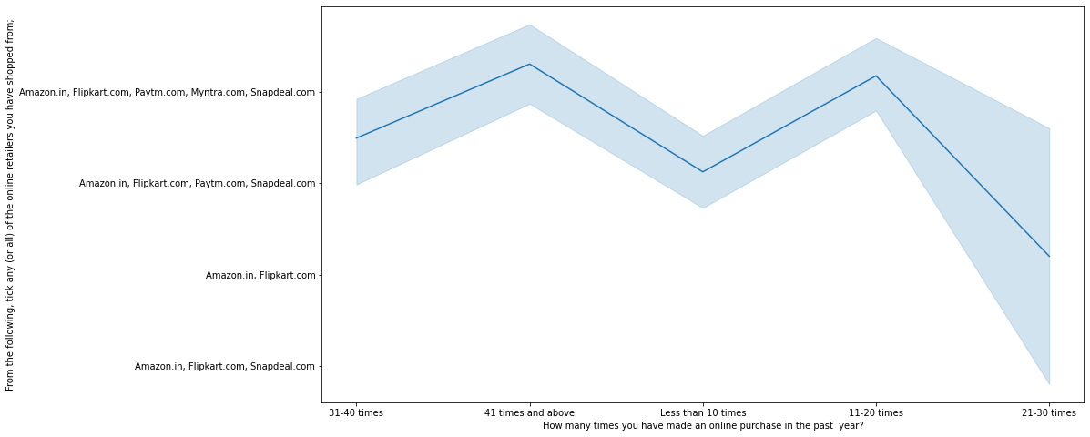
Observation:
People shopping for 41 times and above times and also 11 to 20 times includes all the five sites mentioned.
People shopping for 31-40 times, less than 10 times exclude mytra.com.
People shopping for 21-30 times generally choose amazon and flipcart.

Slide 15
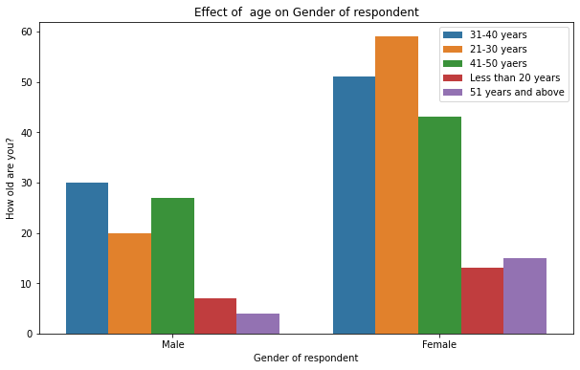
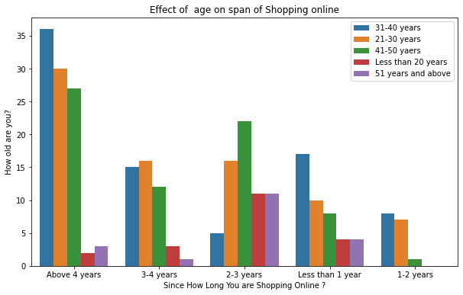
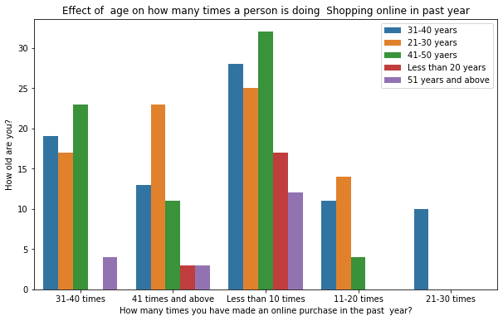
Personal detail in comparison with respect to age group
Female of 21-30 years is responding most whereas male of 31-40 years responding most.
Less than 20 years and more than 50 years age people are spending less time in shopping.
3. Age group of 21-50 years are spending most dutind last 4 years.
4. Age group of 21-50 years people are spending most in all categories of no of times online purchases in past year but maximum is less than 10 years which needs to be increased.

Slide 16
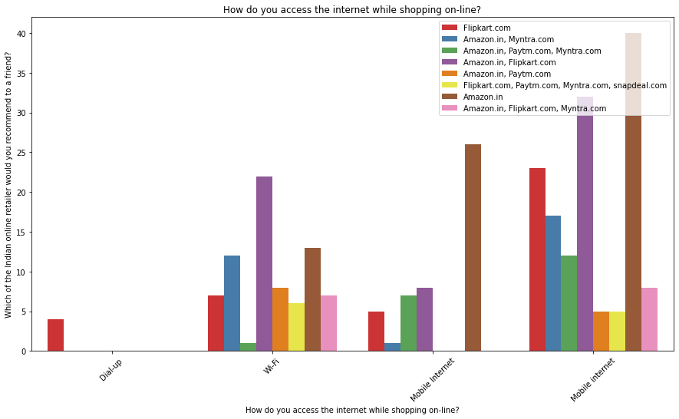
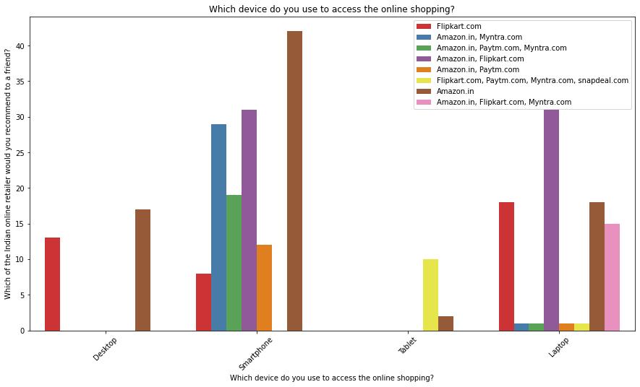
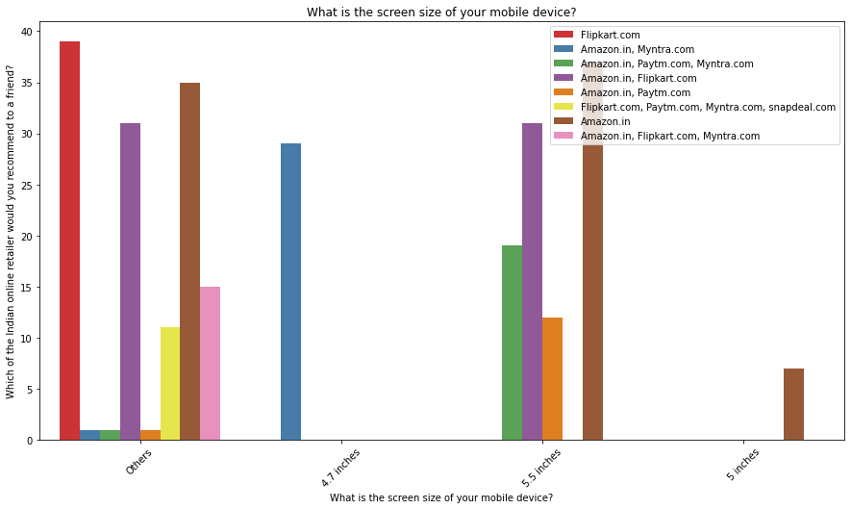
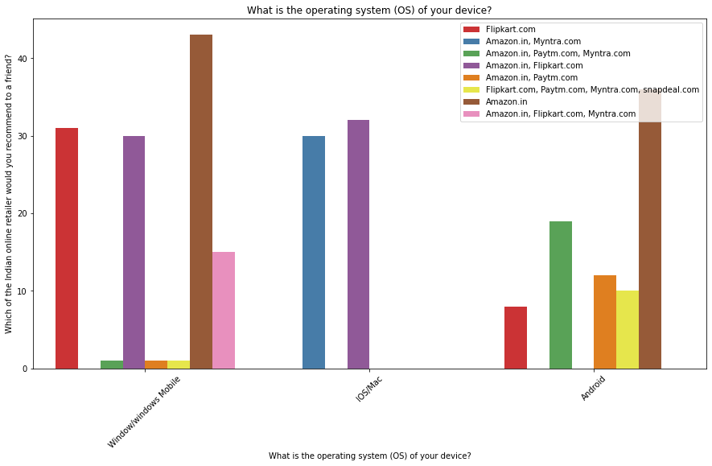
* From the below plotting we can clearly observe that most of the users are mobile users ,using mobile internet, of no such restrictions on screen size but yes mostly people are using Windows or Windows mobile. * Most of the feedbacks are collected from Amazon.in

Slide 17
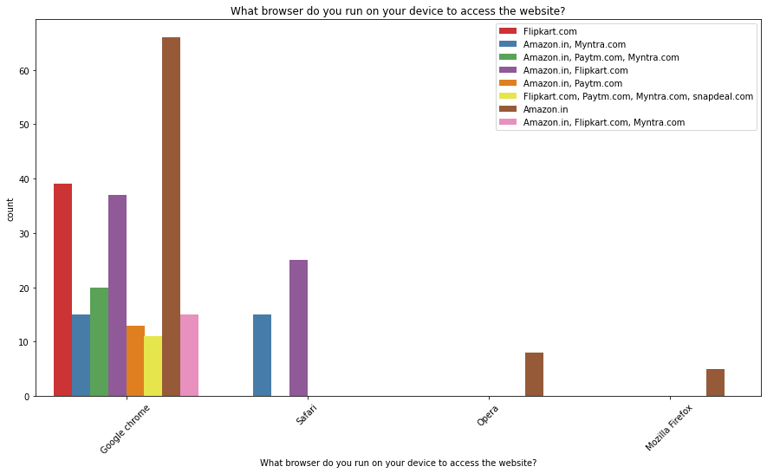
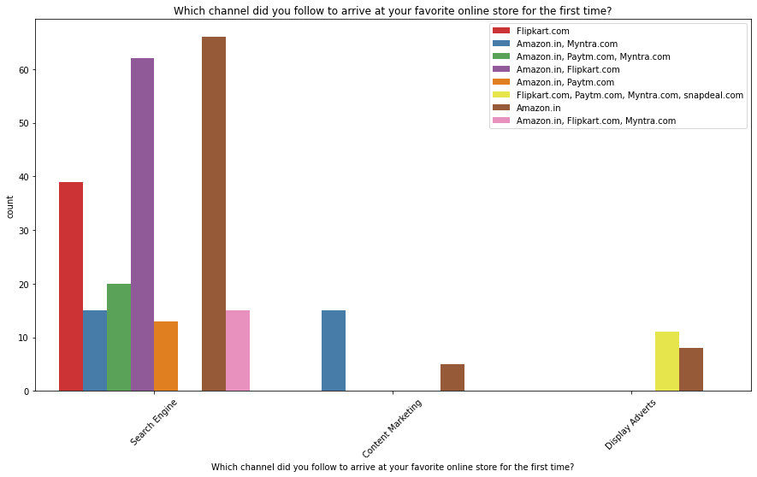
Customer_activity
Google chrome is the most preferred browser through serach engine.
Second visit is also through search engine.

Slide 18
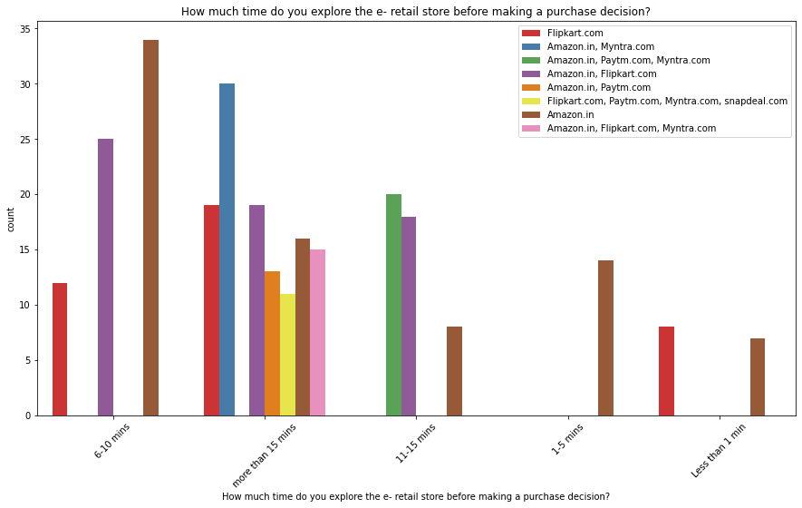
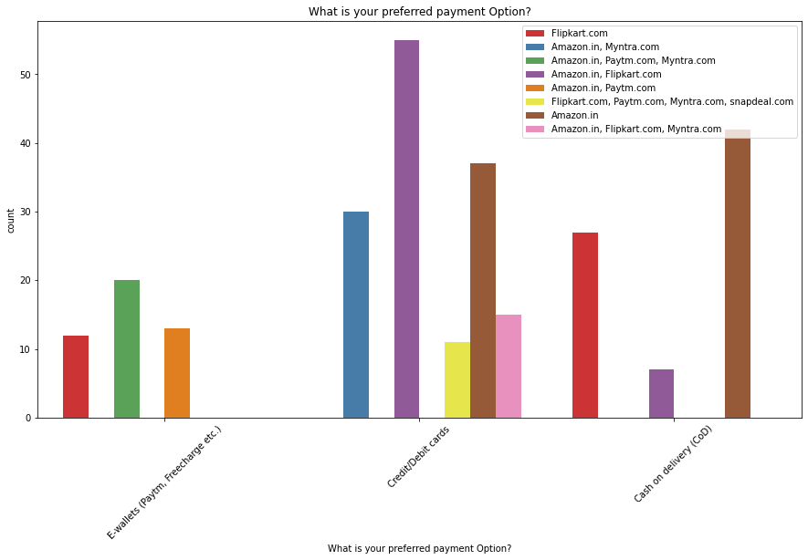
Customer_activity
Amazon and Flipcart users spend between 6 to 10 mins.
The most preffered payment mode is credit and debit card.

Slide 19
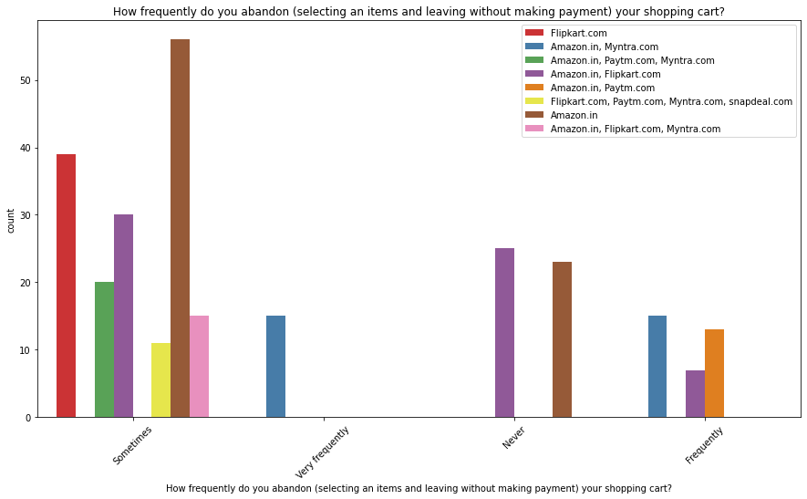
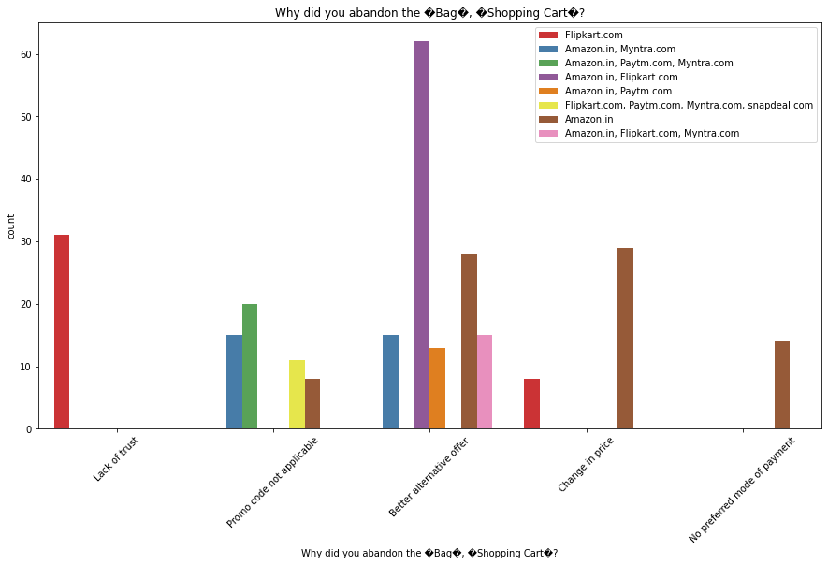
* We can clearly observe that most of the time people abandon the bag is because they get a better alternative offer or promo code not applicable. * There is also lack of trust seen in Amazon, Flipkart and Paytm by some people followed by Snap deal and Myntra.

Slide 20
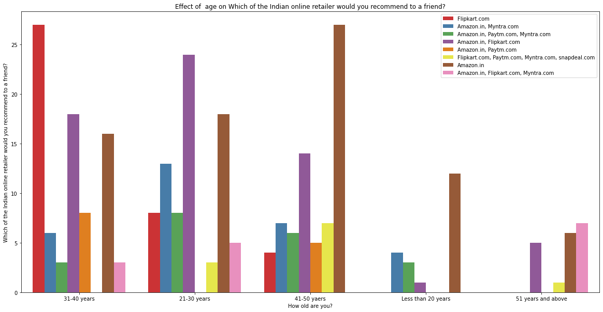
Seeing the dataset we can clearly identify that label feature is 'Which of the Indian online retailer would you recommend to a friend?'

Slide 21
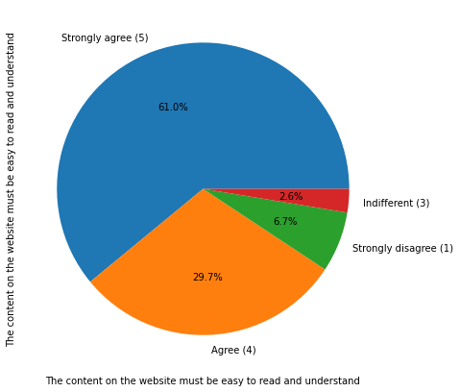
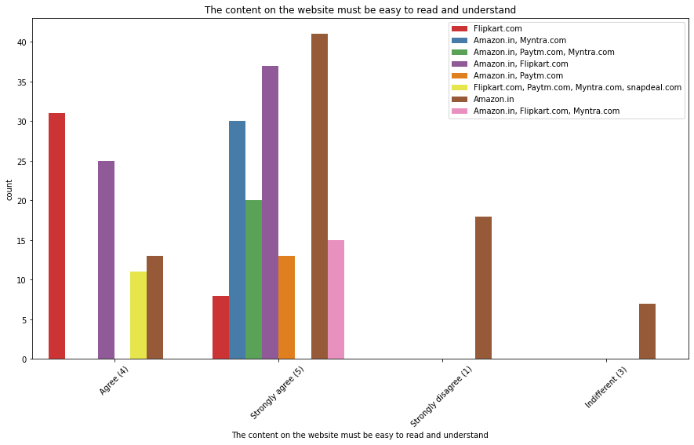
61% people strongly agree that the website should be easy to understand and recommending Amazon for that followed by Amazon and Flipcart combination.

Slide 22
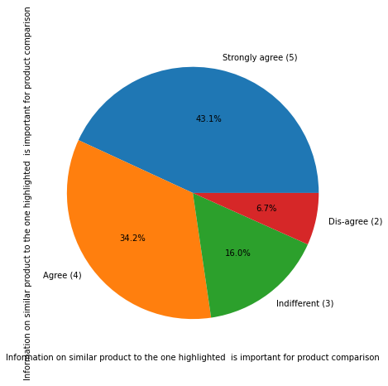
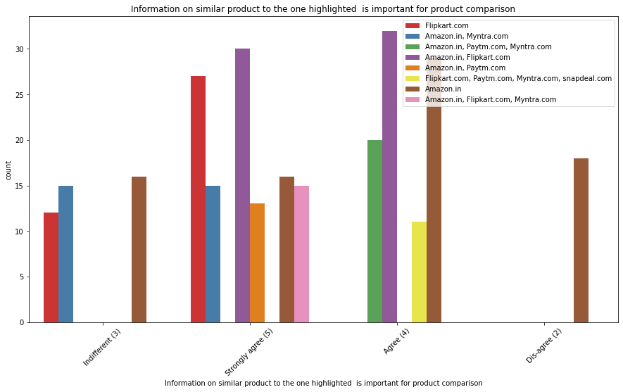
43% people strong agree that information on similar product highlighted is important for product comparision specially people using combination of Flipcart and Amazon.

Slide 23
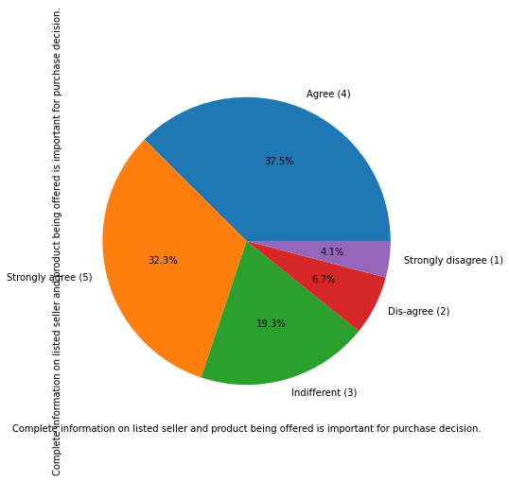
Most of the Amazon customer agree and strongly agree that complete information for purchasing decision

Slide 24
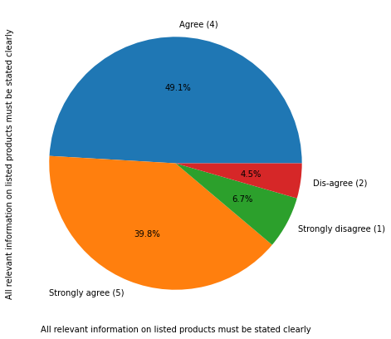
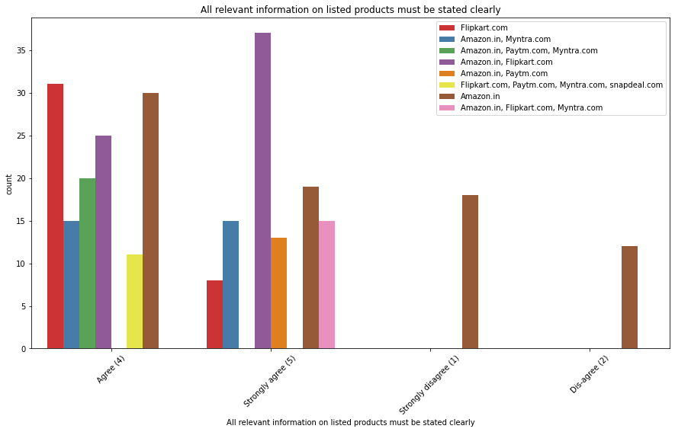
Around 40% people those using Amazon and Flipcart are strong agreeing that all relevent information on listed products must be clearly stated . So the sites should work upon the information part so that the existing customers recommend the site to their friends.

Slide 25
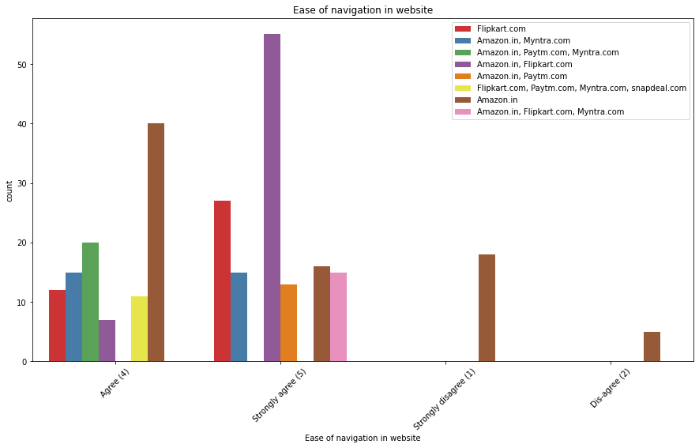
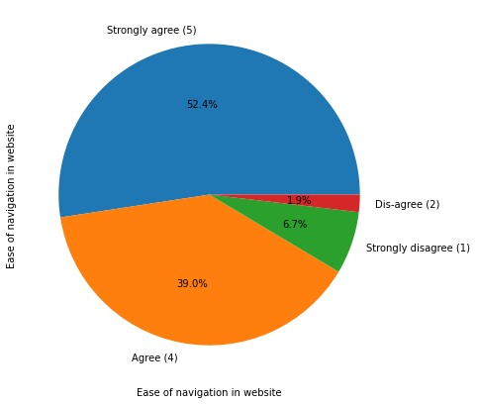
Around 52.4% people strongly agree that if the sites are easy to navigate they can increase new customers from the exsisting friends recommendation.

Slide 26
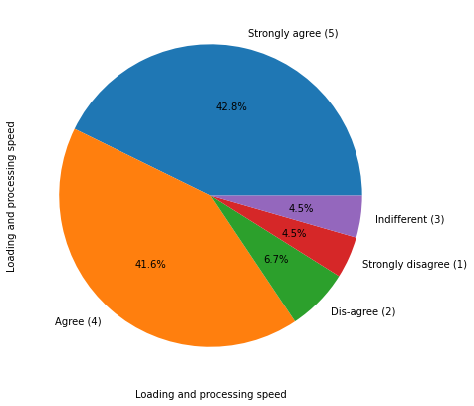
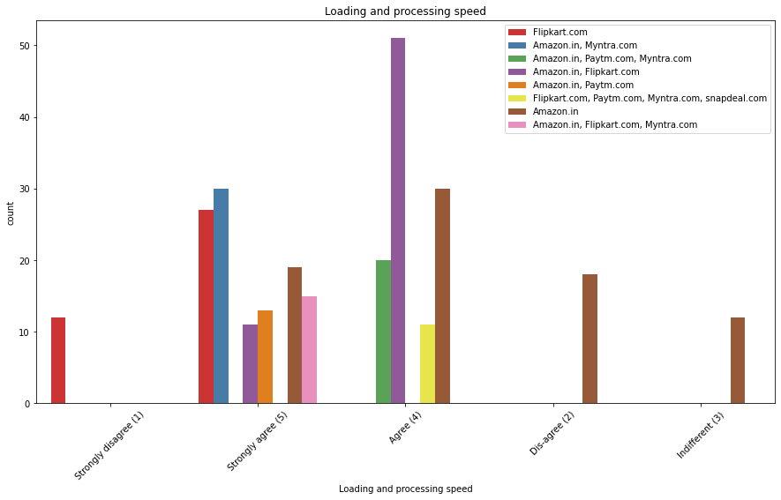
People strongly believe that loading and processing must be high.

Slide 27
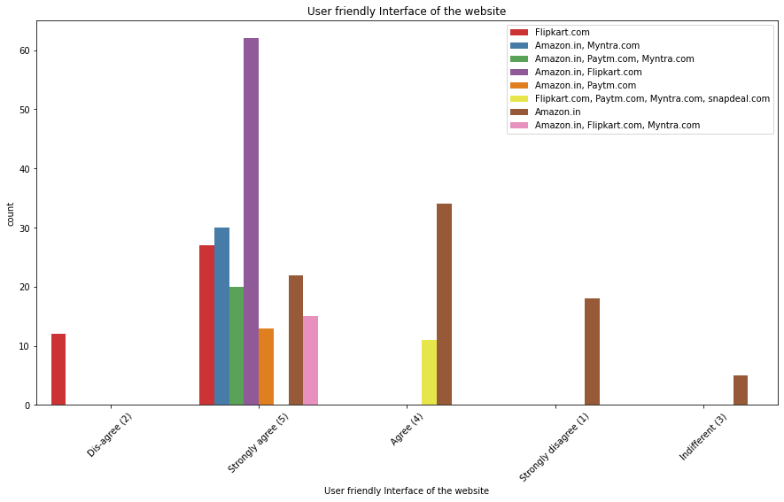
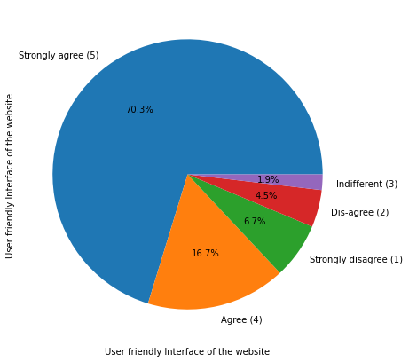
Interactive interface matters a lot to increase the customer retention as well as recommendation to new customers.

Slide 28
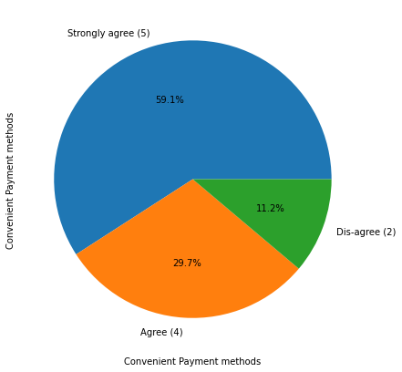
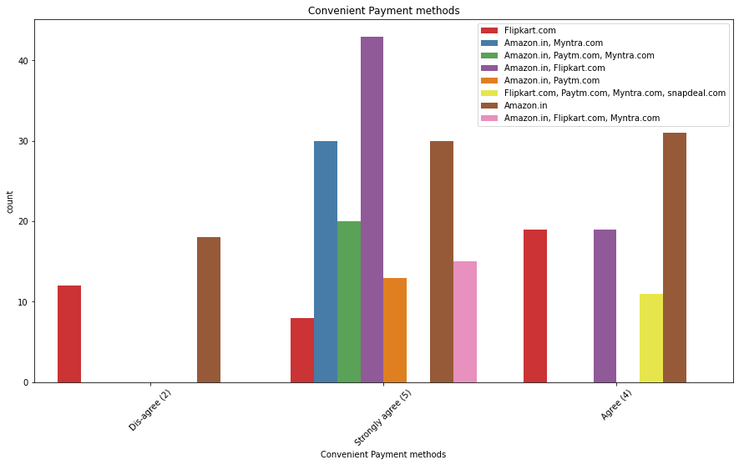
Paymode also plays an important role for suggesting new customers. More the ease and secure for people ,they suggest the more.

Slide 29
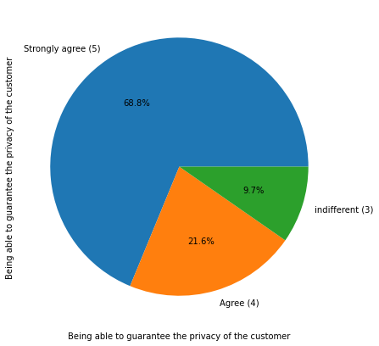
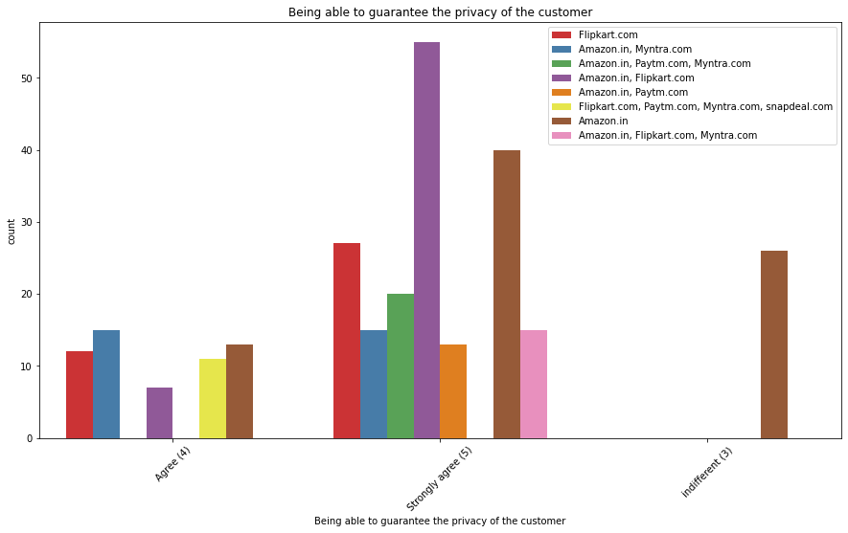
Around 69% people strongly believe that Flip cart and amazon is giving garuntee on customer privacy.

Slide 30
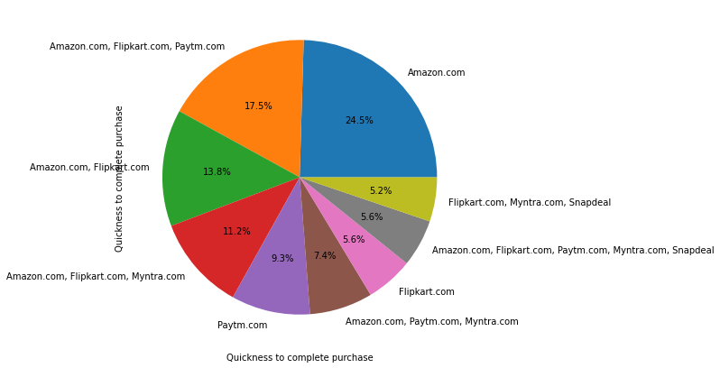
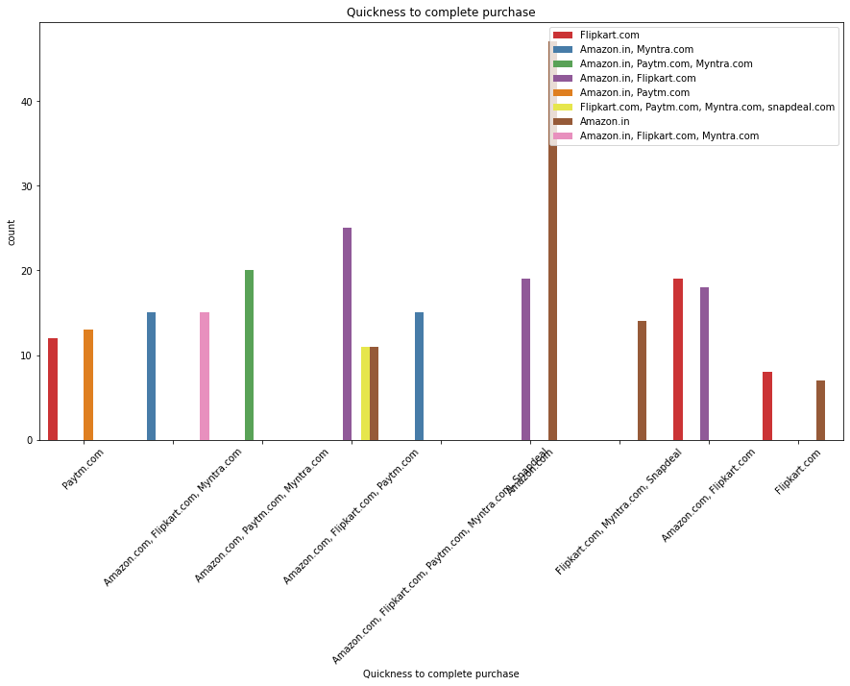
Quickness in purchase is highest in case of Amazon.in.

Slide 31
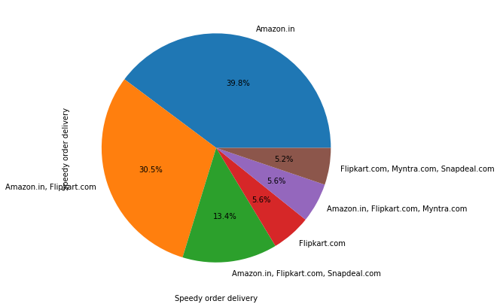
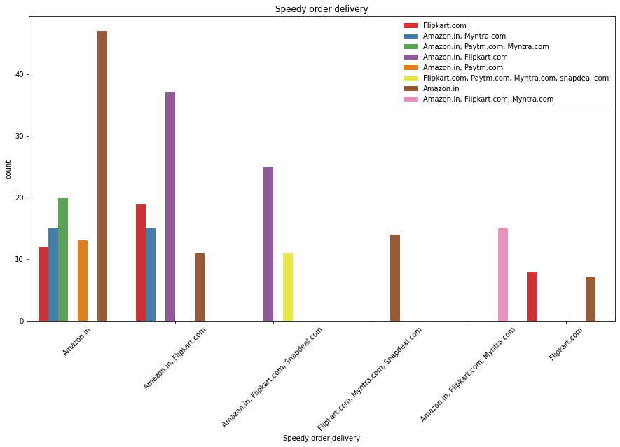
Speedy Order delivery rate is highest for Amazon followed by Combination of Amazon and Flipcart.

Slide 32
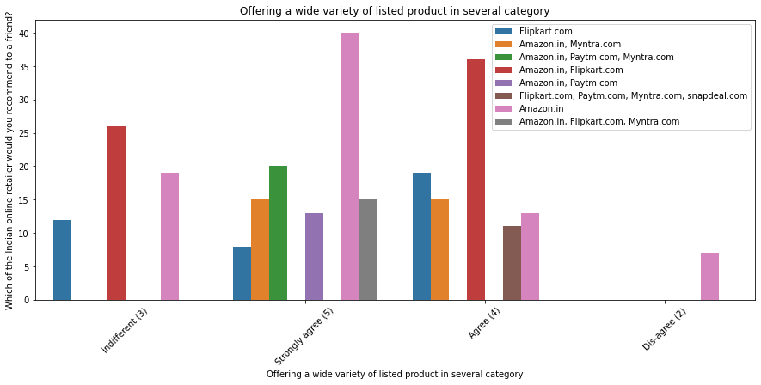
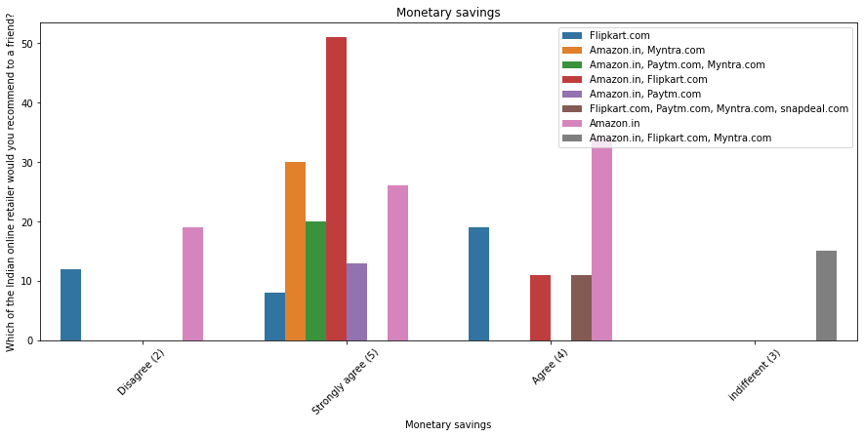
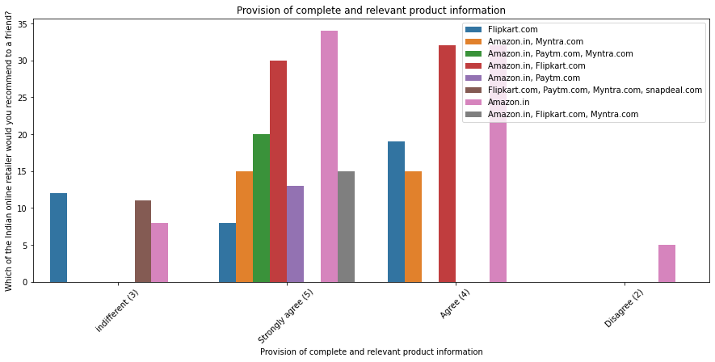
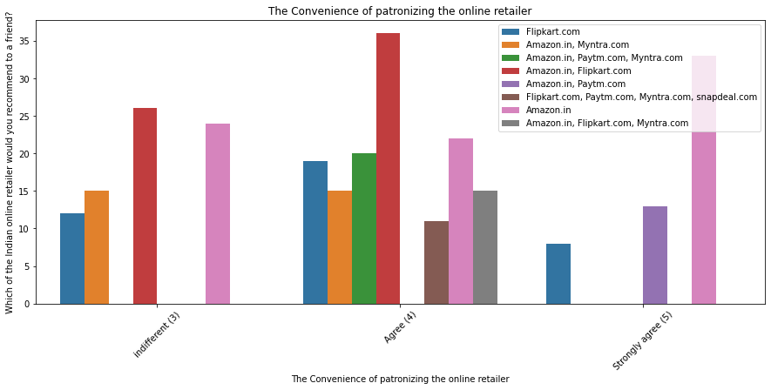
Policies and commitments

Slide 33
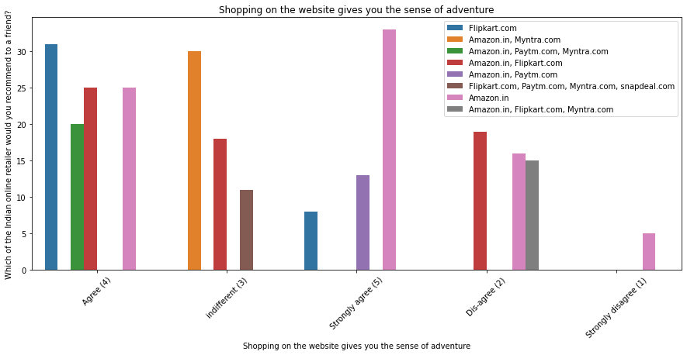
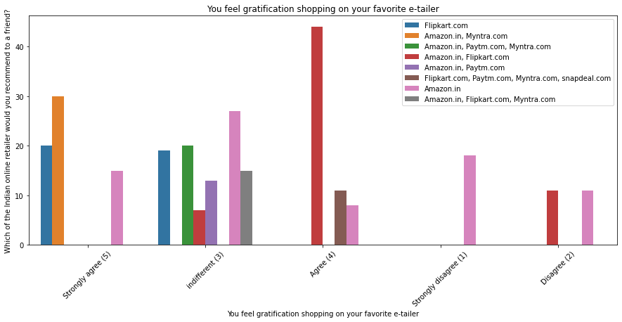
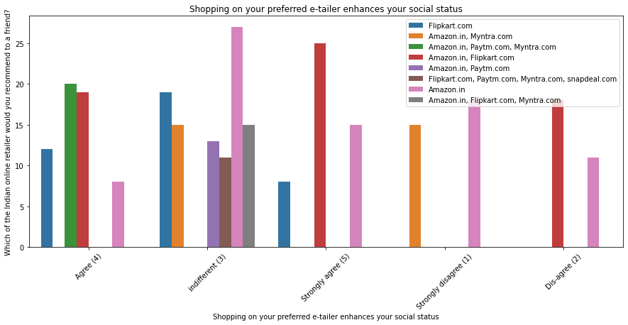
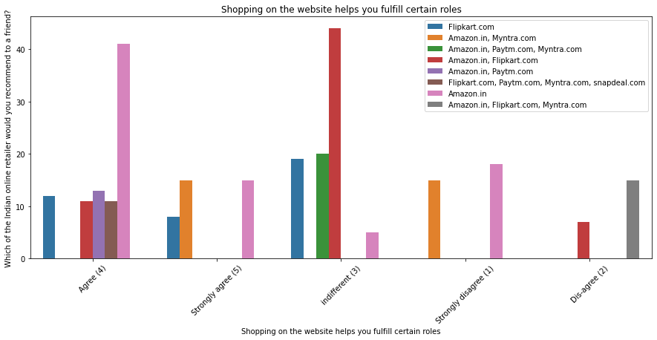
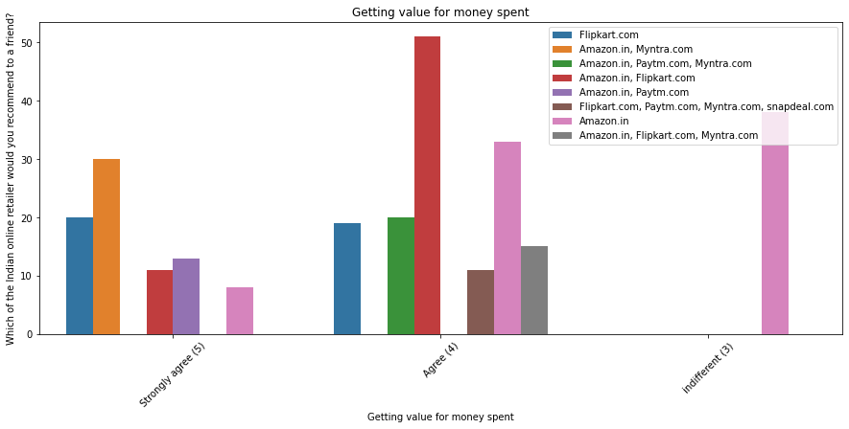
From the below plottings we can infer that most customers of Amazon and flipcart is giving much response regarding the satisfaction of policies.

Slide 34




Website Specification

Slide 35




Website Specification

Slide 36




We can clearly see that Amazon and flipcart are giving their responses most regarding the website specifications and ease of usability. As other sites are less in demand so getting less feedback on website.

Slide 37




Feedback:

Slide 38




Customers seem to be more loyal to amazon, flipkart and paytm as even though many of them have given negative remarks about them still they would recommend these websites to their friend.

Slide 39

* We can clearly observe that most of the time people abandon the bag is because they get a better alternative offer or promo code not applicable. * There is also lack of trust seen in Amazon, Flipkart and Paytm by some people followed by Snap deal and Myntra.

Slide 40


Conclusion: If we compare all sites highest recommendation is for Amazon alone, then followed by Amazon and Flipcart,then amazon,flipcart,paytm depending on the efficiency of the website as before inspite of any kind osf feedbacks( Positive or negative)

Slide 41


